Slide 1

Chapter 2: Installing Linux
Course Title: centos Linux
Instructor : Ayanle Yusuf elm

Slide 2
Centos 7 installing
The screenshots below will show every step from starting the virtual machine for the first
time (with the .iso file attached) until the first logon.
You should see this when booting, otherwise verify the attachment of the .iso file form the
previous steps. Select Test this media and install Centos 7.

Slide 3
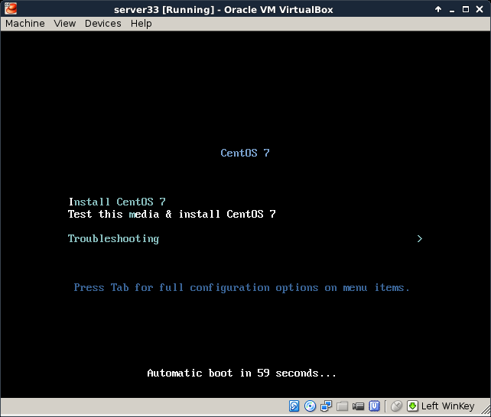
Course Title: centos Linux
Instructor : Ayanle Yusuf elm

Slide 4
Carefully select the language in which you want your Centos. I always install operating
systems in English, even though my native language is not English.
Also select the right keyboard, mine is a US qwerty, but yours may be different.
Course Title: centos Linux
Instructor : Ayanle Yusuf elm

Slide 5
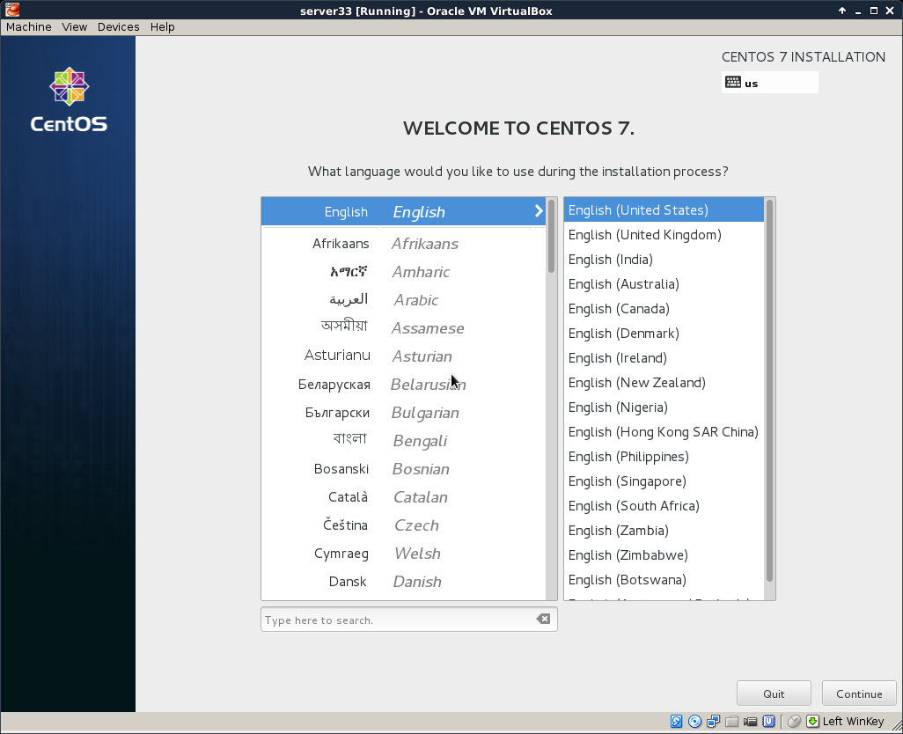
Course Title: centos Linux
Instructor : Ayanle Yusuf elm

Slide 6
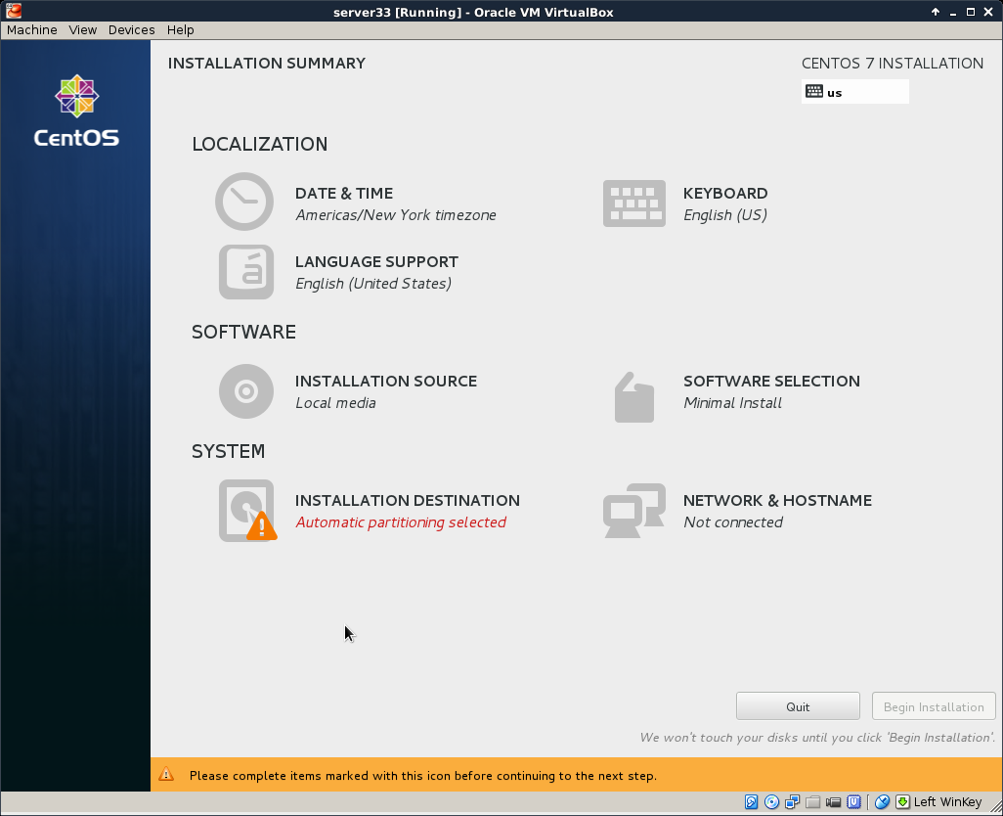
You should arrive at a summary page (with one or more warnings).
Course Title: centos Linux
Instructor : Ayanle Yusuf elm

Slide 7
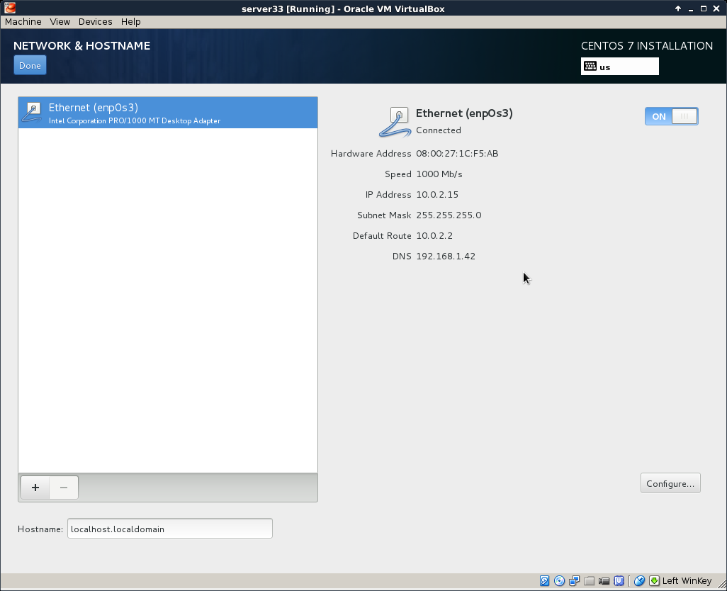
Start by configuring the network. During this demonstration I had a DHCP server running
at 192.168.1.42, yours is probably different. Ask someone (a network administrator ?) for
help if this step fails
Course Title: centos Linux
Instructor : Ayanle Yusuf Elmi

Slide 8
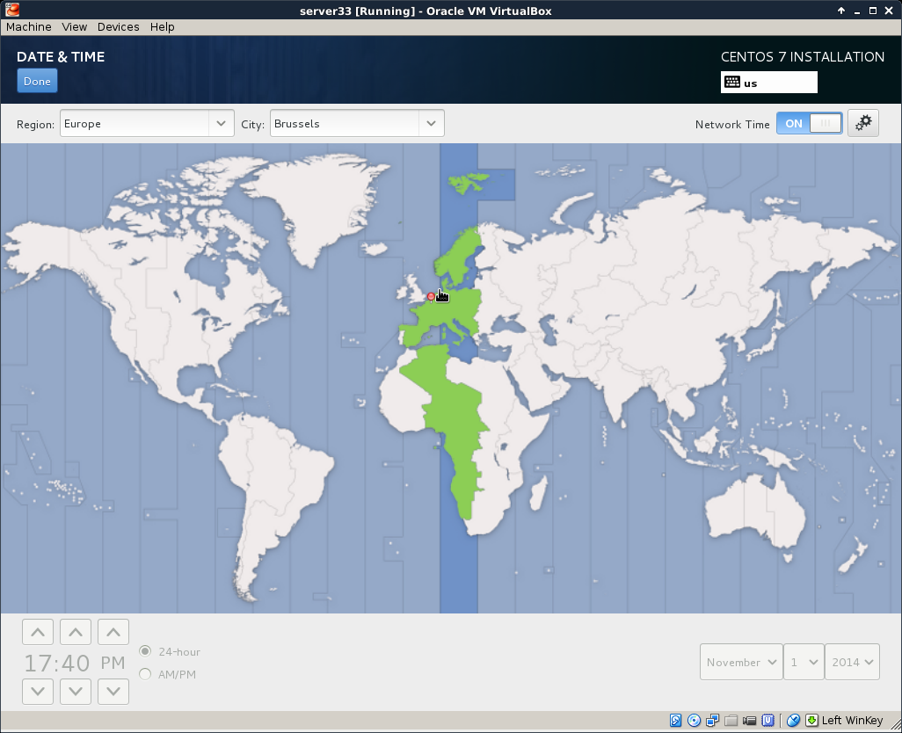
Select your time zone, and activate ntp.
Course Title: centos Linux
Instructor : Ayanle Yusuf elm

Slide 9
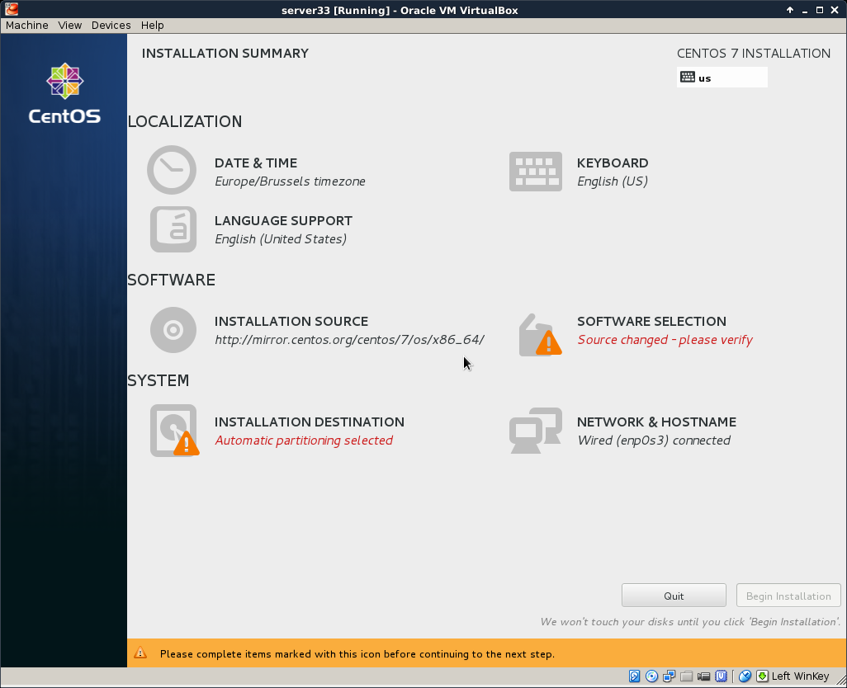
It can take a couple of seconds before the mirror is verified
Course Title: centos Linux
Instructor : Ayanle Yusuf elm

Slide 10
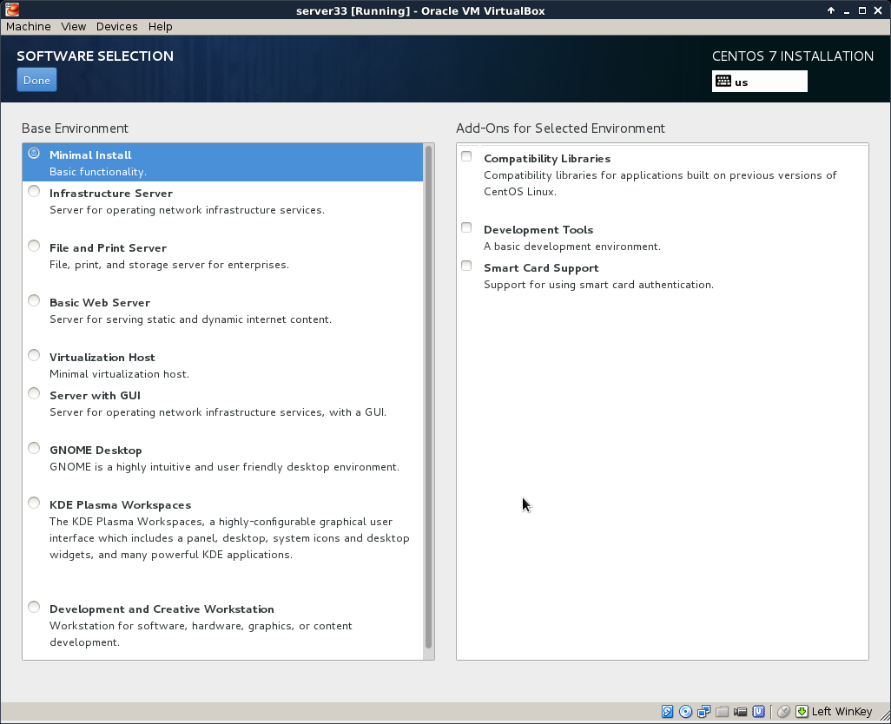
Course Title: centos Linux
Instructor : Ayanle Yusuf elm

Slide 11
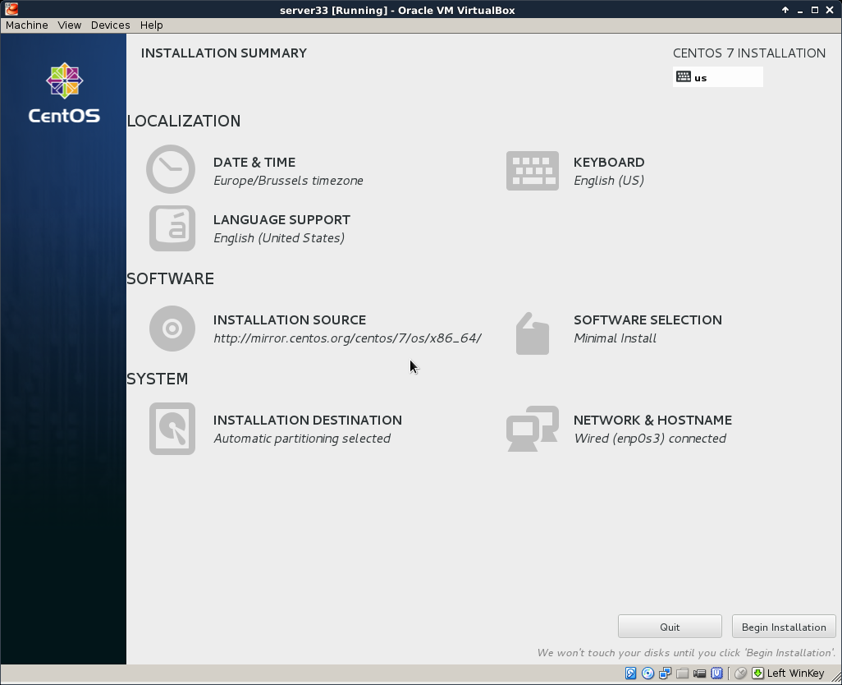
After configuring network, location, software and all, you should be back on this page. Make sure there are no warnings anymore (and that you made the correct choice everywhere).
Course Title: centos Linux
Instructor : Ayanle Yusuf elm

Slide 12
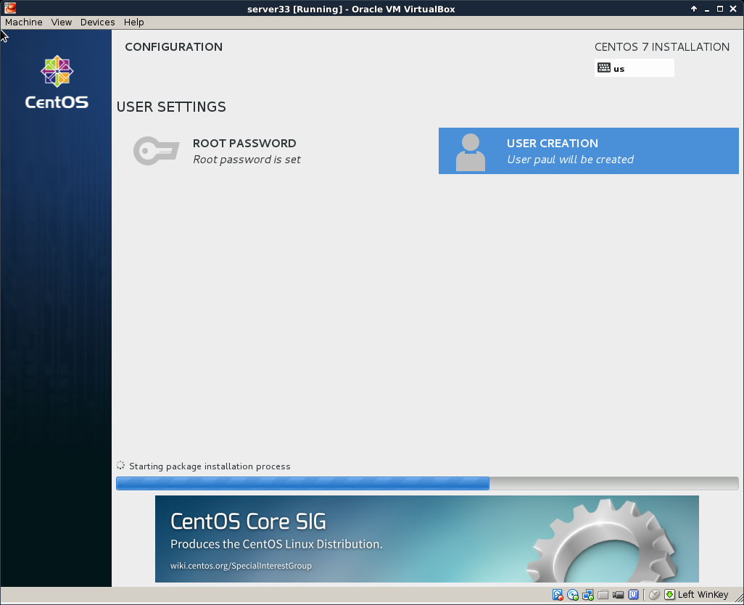
You can enter a root password and create a user account
Course Title: centos Linux
Instructor : Ayanle Yusuf Elm

Slide 13
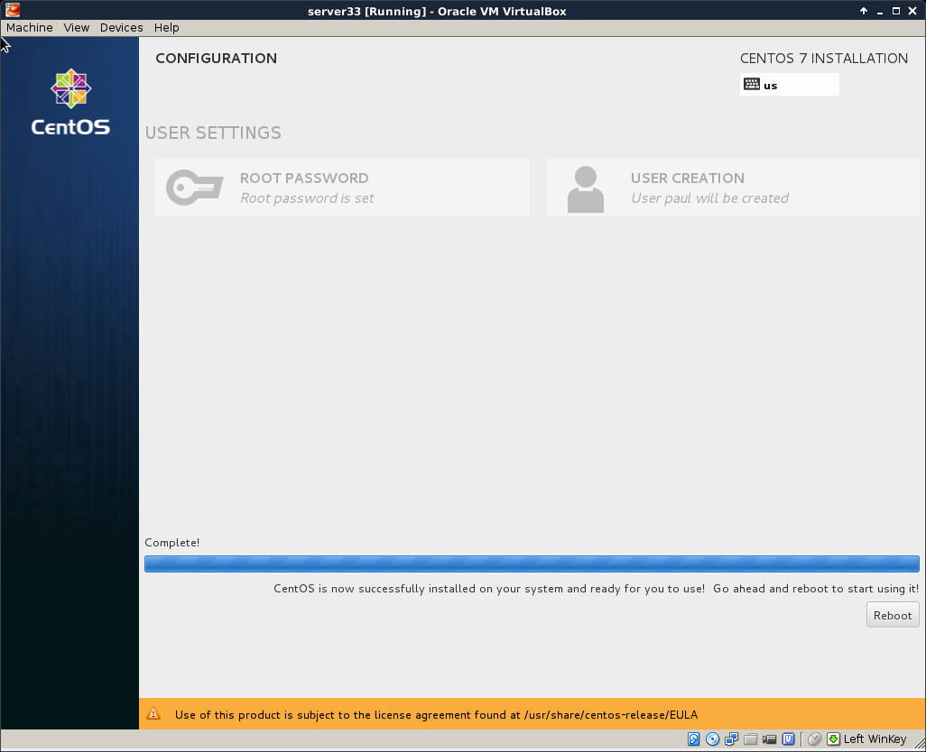
If you see this, then the installation was successful.
Time to reboot the computer and start CentOS 7 for the first time.
Course Title: centos Linux
Instructor : Ayanle Yusuf elm

